Slide 1
CORE TOPICS

Slide 2






FRAGMENT
LISTVIEW
ADAPTER DEMO

Slide 3
FRAGMENT
Represents a behavior or a portion of user interface in a FragmentActivity
Android introduced fragments in Android 3.0 (API level 11)
You can combine multiple fragments in a single activity to build a multi-pane UI and reuse a fragment in multiple activities
Can add and remove while activity running. Call as sub activity

Slide 4
FRAGMENT
Example when you have music app with playlist. Playlist can have in every activity
A fragment must always be hosted in an activity
The fragment's lifecycle is directly affected by the host activity's lifecycle.
For example, when the activity is paused, so are all fragments in it, and when the activity is destroyed, so are all fragments.

Slide 5
FRAGMENT
When you add a fragment as a part of your activity layout, it lives in a ViewGroup inside the activity's view hierarchy and the fragment defines its own view layout.

Slide 6
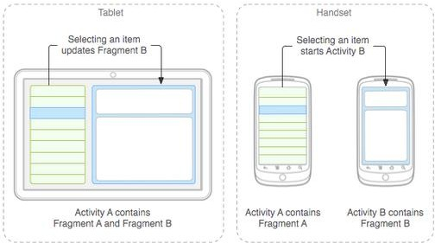
DESIGN
Think of how to modular and re-use
Add component for large screen and remove for small screen

Slide 7
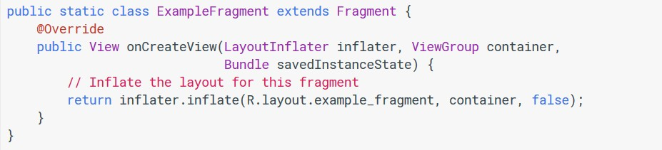
IMPLEMENT FRAGMENT
Step1: extend Fragment class and implement OnCreateView() method

Slide 8
IMPLEMENT FRAGMENT
Step2: add Fragment to Activity layout
<?xml version="1.0" encoding="utf-8"?>
<LinearLayout xmlns:android="http://schemas.android.com/apk/res/android"
android:orientation="horizontal" android:layout_width="match_parent" android:layout_height="match_parent">
<fragment android:name="com.example.news.ExampleFragment" android:id="@+id/list"
android:layout_weight="1" android:layout_width="0dp" android:layout_height="match_parent" />
</LinearLayout>

Slide 9
IMPLEMENT FRAGMENT
Replace / add / remove fragment when activity running
FragmentManager fragmentManager = getSupportFragmentManager(); FragmentTransaction fragmentTransaction = fragmentManager.beginTransaction();
ExampleFragment fragment = new ExampleFragment(); fragmentTransaction.add(R.id.fragment_container, fragment); fragmentTransaction.commit();

Slide 10
IMPLEMENT FRAGMENT
Another things can do with fragment
Get fragments that exist in the activity, with findFragmentById() (for fragments that provide a UI in the activity layout) or findFragmentByTag() (for fragments that do or don't provide a UI).
Pop fragments off the back stack, with popBackStack()
(simulating a Back command by the user).
Register a listener for changes to the back stack, with
addOnBackStackChangedListener().

Slide 11
COMMUNICATE WITH ACTIVITY
the fragment can access the FragmentActivity instance with getActivity() and easily perform tasks such as find a view in the activity layout:

Slide 12
OTHER THINGS
Callback event in fragment to share data
Adding item in AppBar

Slide 13
FRAGMENT
LISTVIEW
ADAPTER DEMO

Slide 14
LISTVIEW
Android ListView is a view which groups several items and display them in vertical scrollable list.
The list items are automatically inserted to the list using an Adapter that pulls content from a source such as an array or database.

Slide 15
ADAPTER
An adapter is a bridge between UI components and the data source that fill data into UI Component
The list items are automatically inserted to the list using an Adapter that pulls content from a source such as an array or database.
Adapter holds the data and send the data to view
View can takes the data from adapter view and shows the data on different views like as spinner, list view, grid view etc

Slide 16
ADAPTER
ArrayAdapter
Base Adapter
CursorAdapter,
SimpleCursorAdapter
SpinnerAdapter
WrapperListAdapter

Slide 17
IMPLEMENT LISTVIEW
Declare ListView in layout with id
Create layout for ListView
Select suitable adapter
Prepare data for adapter
Connect listview and adapter

Slide 18
QUESTION
&
THANK YOU FOR YOUR ATTENTION

